Slide 1
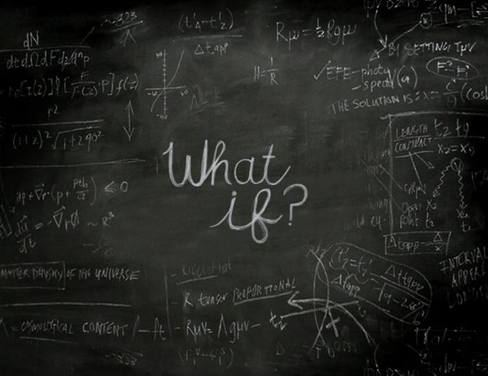
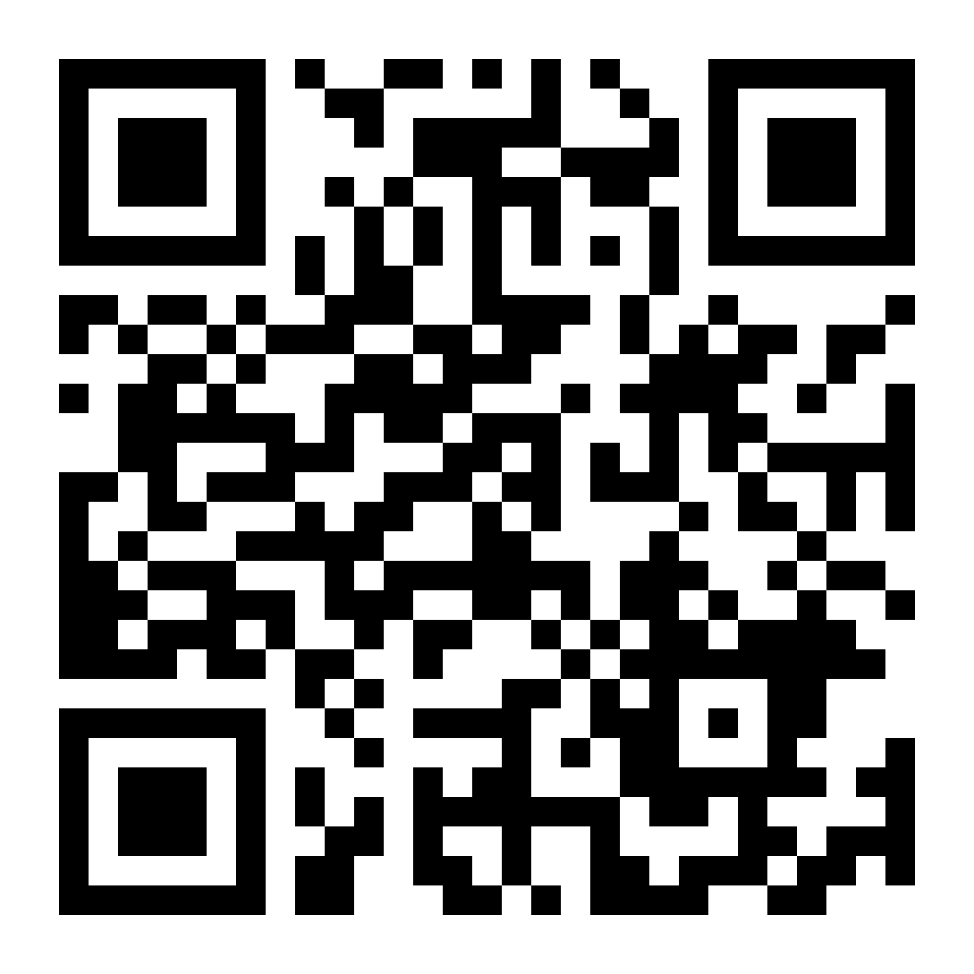
The MakeCamp Pilot Option for Professional Development:
Sociocultural Sustainable Innovation
#MakerPED
Helen Teague
Helen.Teague@pepperdine.edu
Scan the QR-Code
See the Video!

Slide 2
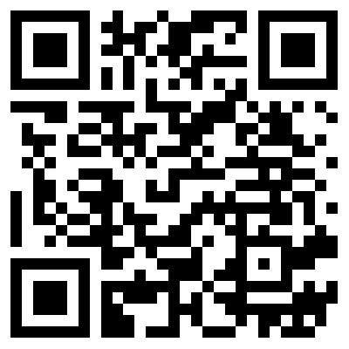
The MakeCamp Pilot Option for Professional Development: Sociocultural Sustainable Innovation
THE IDEA: SITUATING EDUCATIONAL PROFESSIONAL DEVELOPMENT IN MAKERSPACES

Slide 3
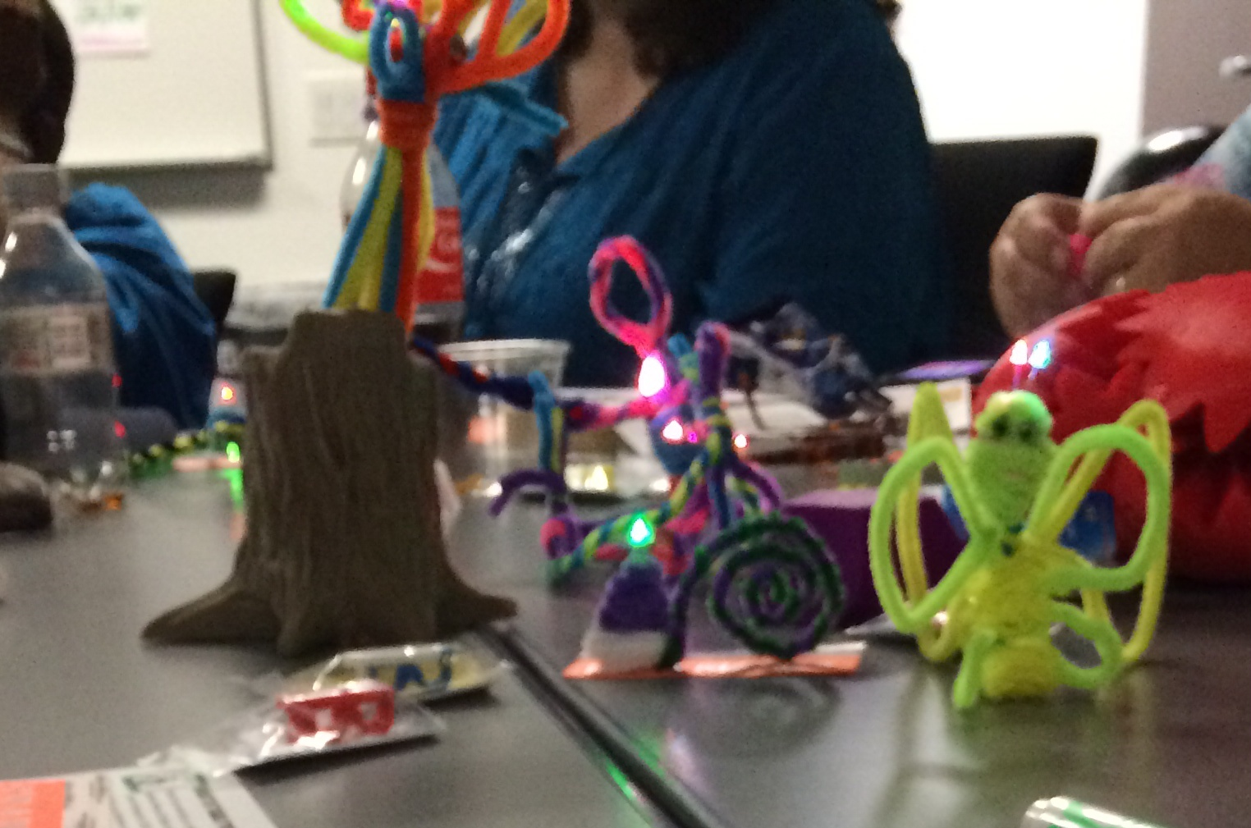
The MakeCamp Pilot Option for Professional Development: Sociocultural Sustainable Innovation
#MakerPED
How can educational,
professional development
re-emerge
into something meaningful
for educators?
Autonomy-Resources-Time-Expert Guidance
Learning about Learning by Learning about Making

Slide 4
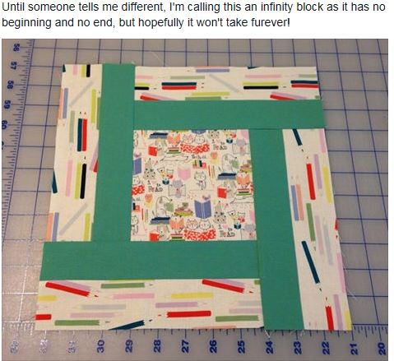
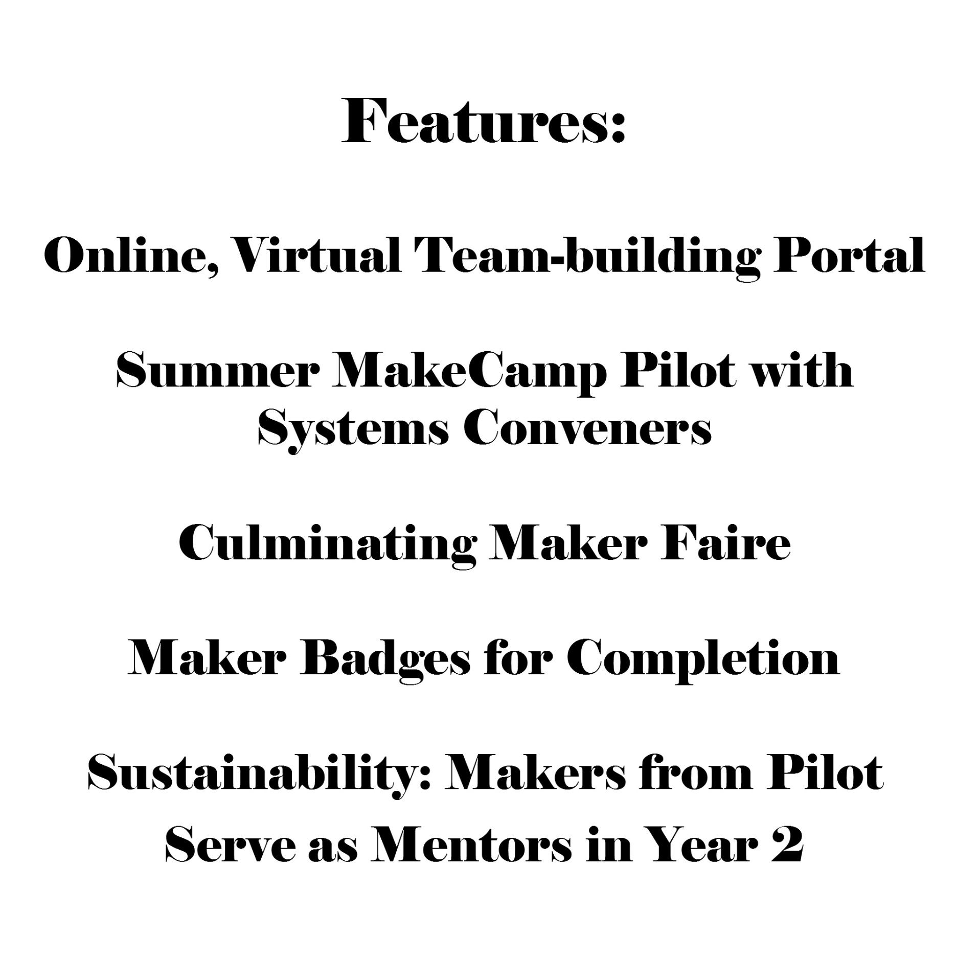
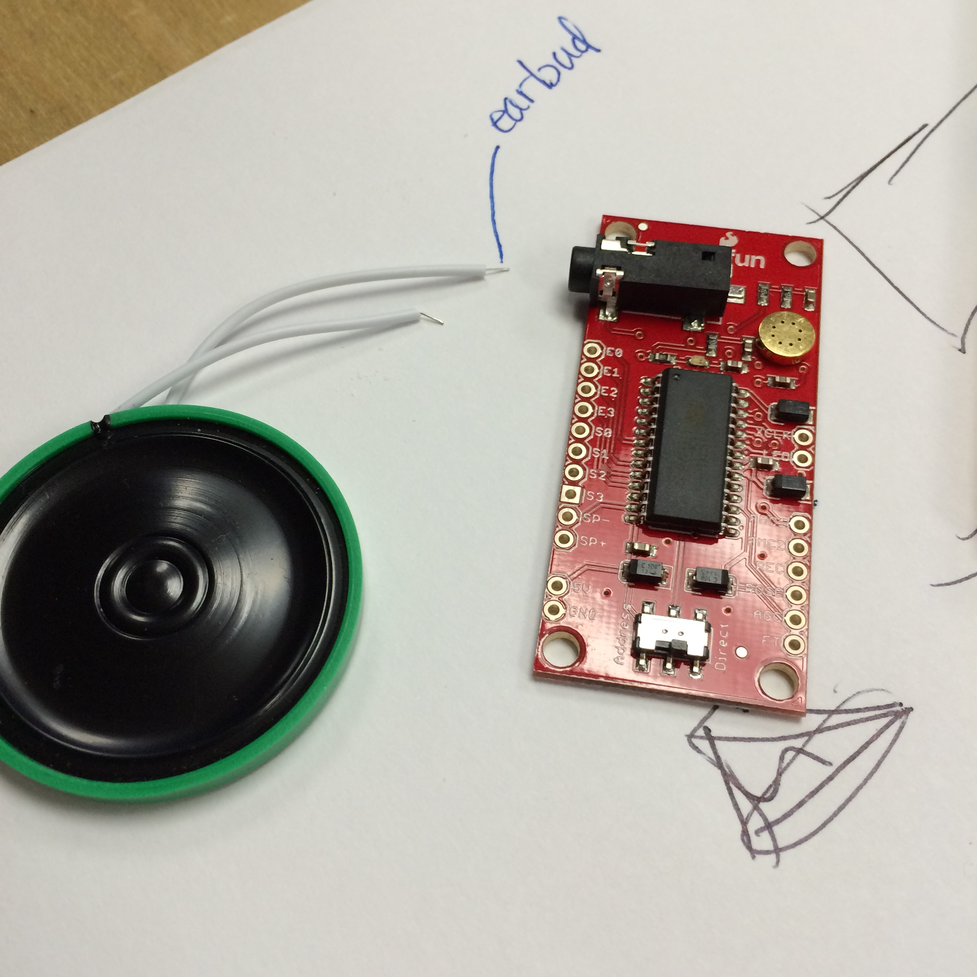
The MakeCamp Pilot Option for Professional Development: Sociocultural Sustainable Innovation
#MakerPED
Autonomy ~
Resources ~
Time ~
Expert Guidance

Slide 5
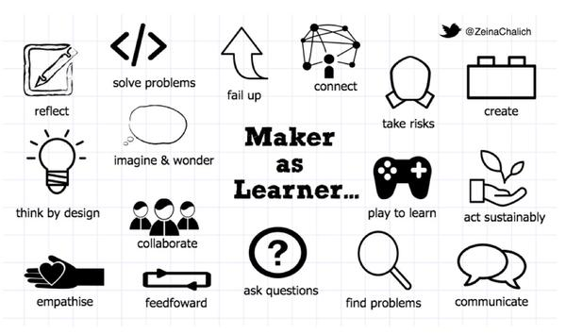
The MakeCamp Pilot Option for Professional Development: Sociocultural Sustainable Innovation
#MakerPED

Slide 6
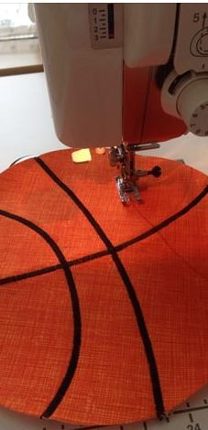
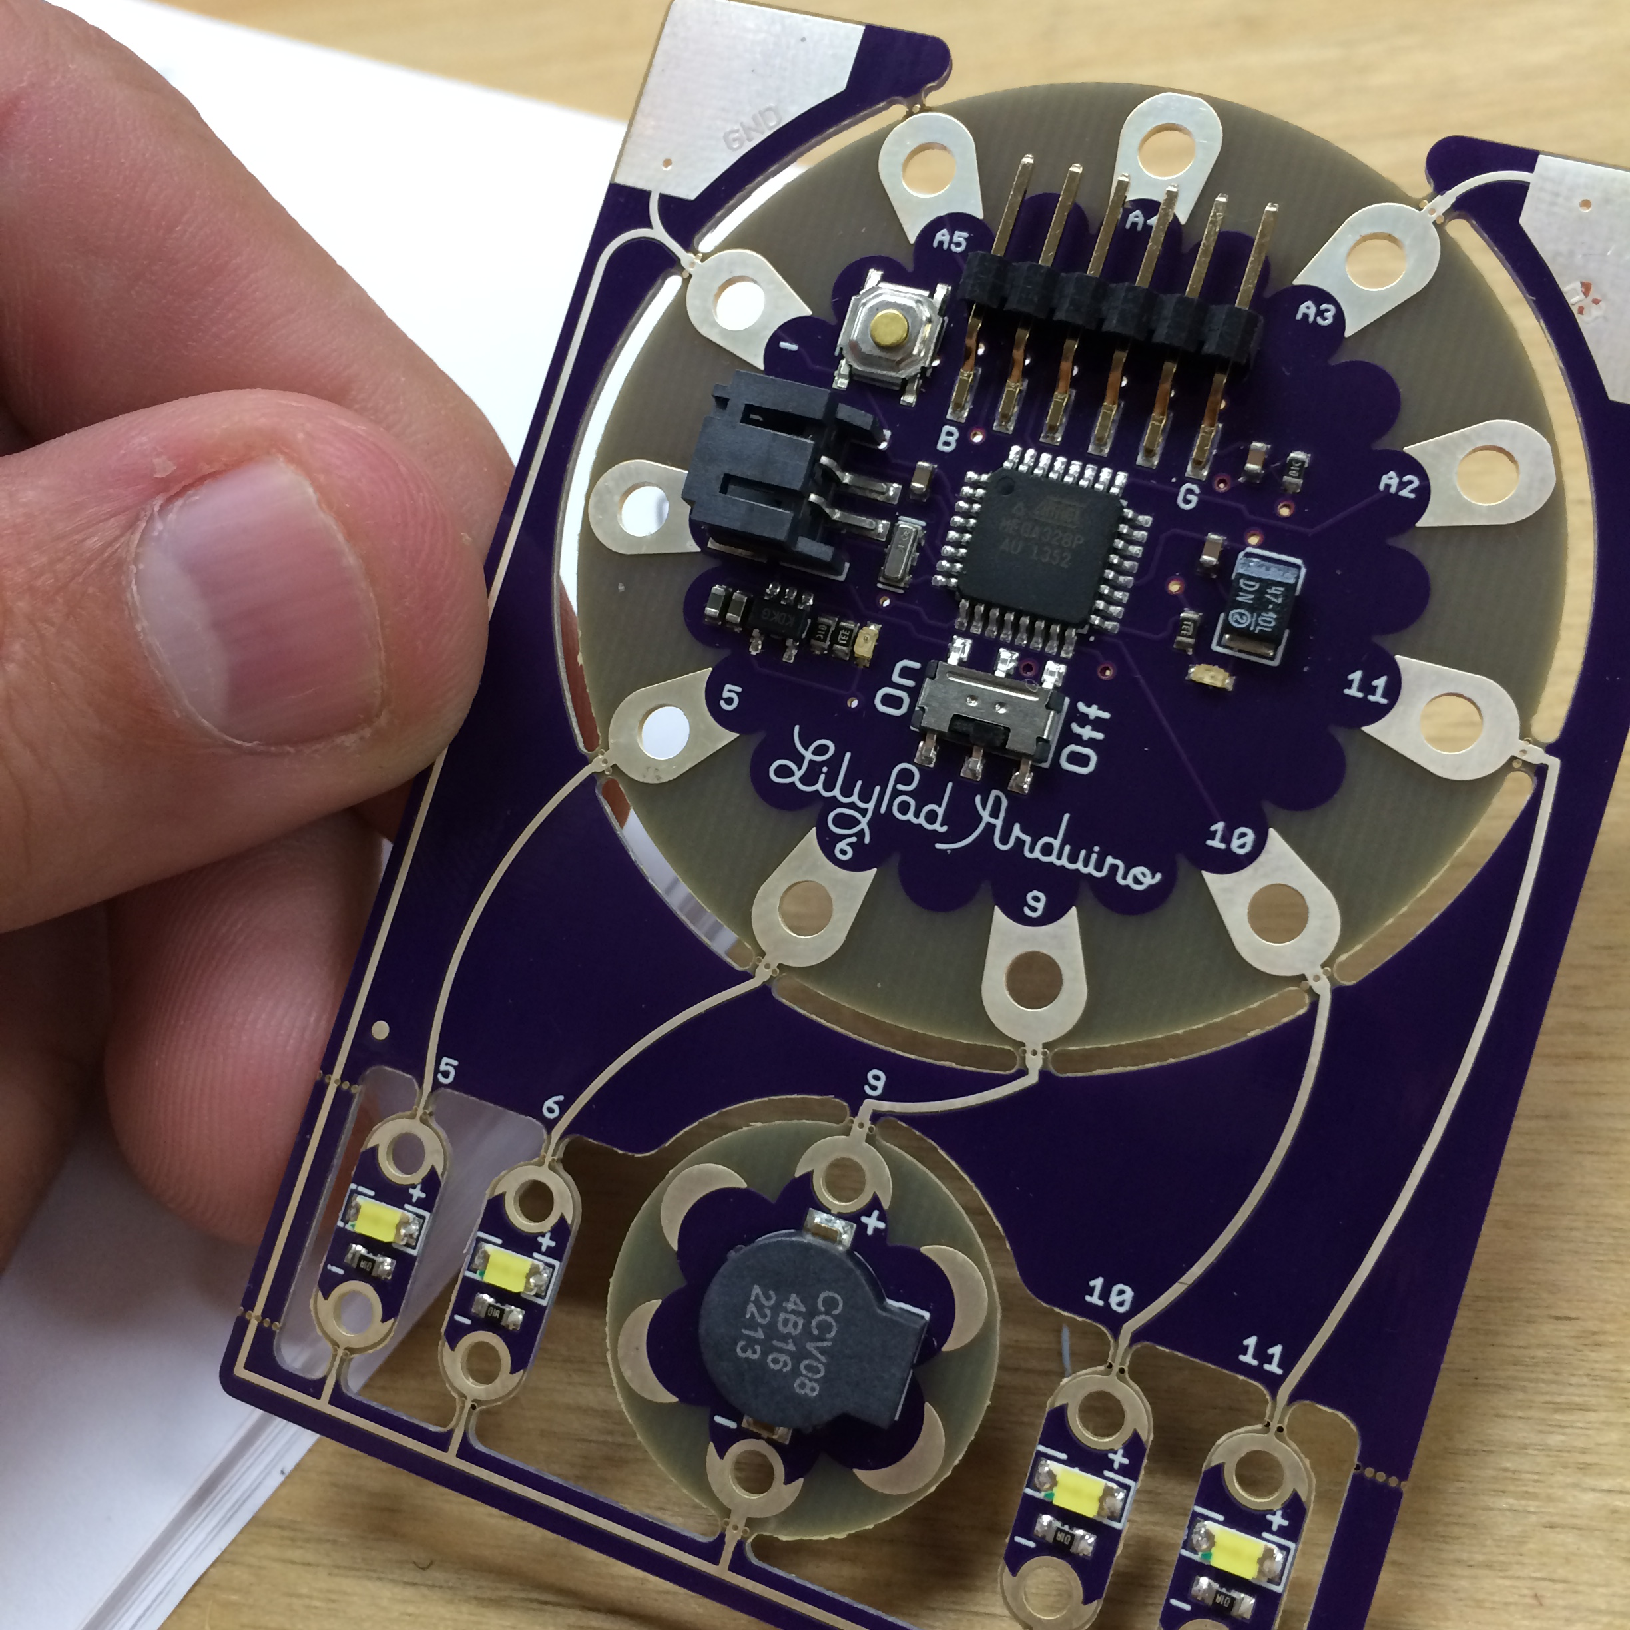
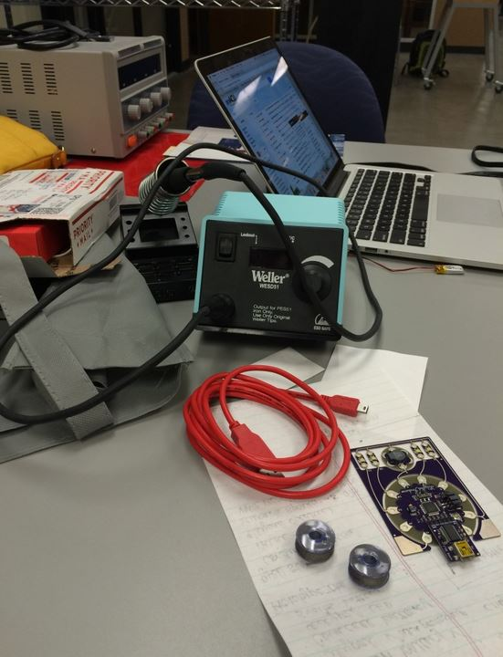

Slide 7
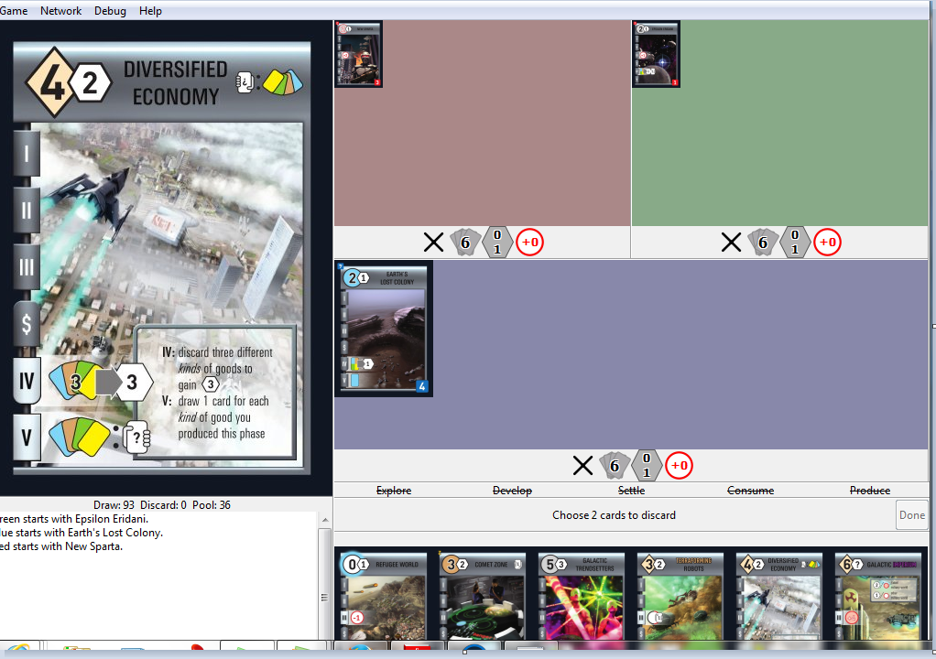
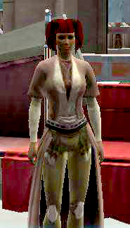
Examples of Maker Products
The MakeCamp Pilot Option for Professional Development: Sociocultural Sustainable Innovation

Slide 8
The MakeCamp Pilot Option for Professional Development: Sociocultural Sustainable Innovation

Slide 9
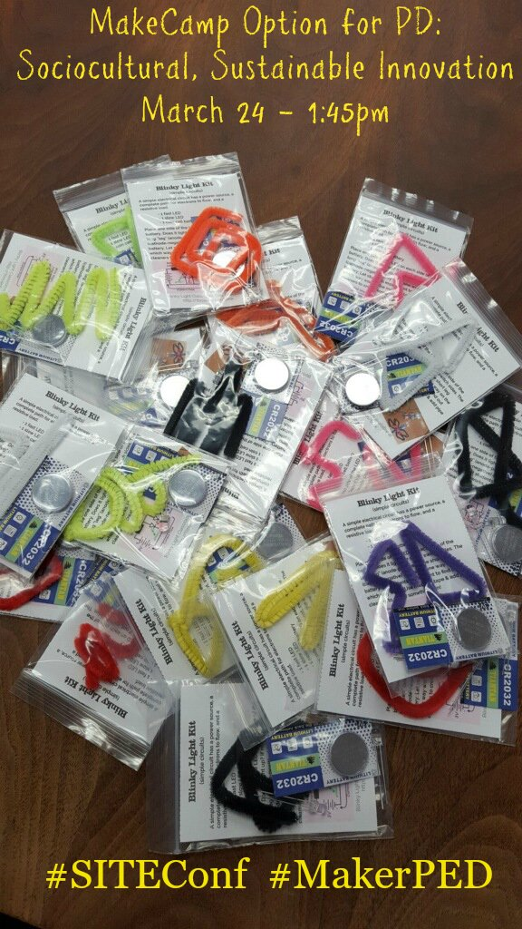
The MakeCamp Pilot Option for Professional Development: Sociocultural Sustainable Innovation
"Curriculums must become more thought-filled in the sense of
enlarging students' capacities to think deeply and creatively."
Costa, "The Thought-Filled Curriculum"
themes to shape curriculum, which include
learning to think,
thinking to learn,
thinking together,
thinking about our own thinking,
And
thinking big.
How does the MakeCamp PED integrate the 5 themes?
Costa, A.L. (2008, February).
The thought-filled curriculum.
Educational Leadership, 65(5), 20-24.
http://www.ascd.org/publications/educational_leadership/
feb08/vol65/num05/The_Thought-Filled_Curriculum.aspx

Slide 10
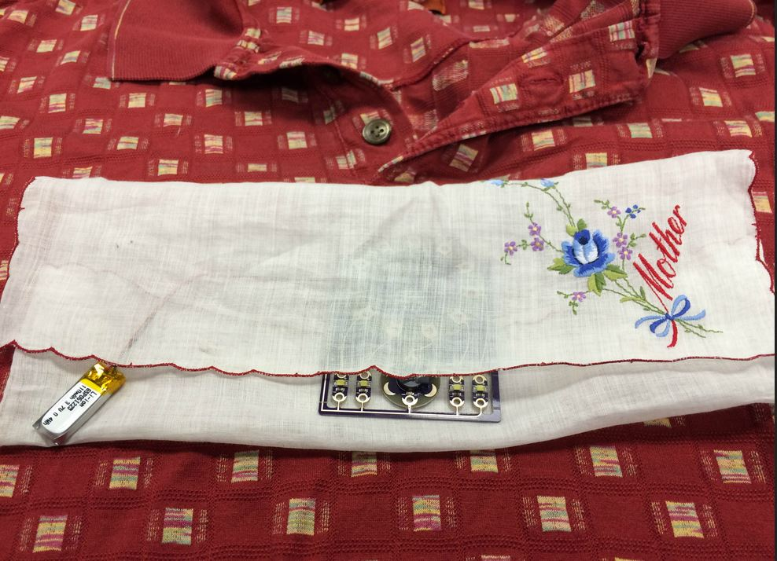
Thank you for attending! For More Information:
The MakeCamp Pilot Option for Professional Development: Sociocultural Sustainable Innovation
Helen.Teague@pepperdine.edu
@tweetTeague

